Slide 1
7PAM2002 · MSc DATA SCIENCE PROJECT · PROJECT PRESENTATION
Predicting Strong-Growth UK Car
Manufacturers
Random Forest & XGBoost classifiers on DfT VEH0160 quarterly registrations
Student: Anandasai Sunke (24025759)
Supervisor: Vid Irsic
GitHub: https://github.com/SunkeAnandasai3784/SMMT-2025-UK-Car-Sales-Analysis

Slide 2
INTRODUCTION
github.com/SunkeAnandasai3784
Motivation & Research Question
Why this matters
RESEARCH QUESTION
UK new-car registrations fell 11.1% in 2024 as buyers shift from petrol to EVs (SMMT, 2023).
But growth is uneven: Tesla +45% YoY, Ford −15% in the same period.
Investors, manufacturers and policymakers need to know which makers will grow — SMMT/DfT reports describe the past, they do not predict.
This project builds a classifier on the official DfT VEH0160 registration data to flag strong-growth manufacturer-quarters.
Can machine-learning models predict whether a car manufacturer will achieve more than 10% year-on-year (YoY) growth in its quarterly registrations?
Success criteria & scope
Target ≥ 90% accuracy to be business-useful.
10% threshold = meaningful growth, not noise.
Compare Random Forest vs XGBoost on tabular data.
Anandasai Sunke · 24025759 · 7PAM2002 Data Science Project
2

Slide 3
DATA
github.com/SunkeAnandasai3784
Dataset & Ethical Considerations
61,226
13,756
2014–2025
14.7%
raw VEH0160 records
manufacturer-quarter rows
Q1 2014 to Q3 2025
are strong-growth (class 1)
Source & structure
Ethical considerations
DfT VEH0160 — “Vehicles registered for the first time”, published quarterly by the Department for Transport (DfT).
CSV table; filtered to BodyType = Cars, then reshaped from wide quarters to a long Make × quarter panel.
SMMT = Society of Motor Manufacturers and Traders (industry source for context figures).
Public government data only — aggregate registration counts.
No personal data: no names, addresses or owner-level details.
Released under a Creative Commons licence (reuse for research and commercial use permitted).
No human participants involved in the project.
Anandasai Sunke · 24025759 · 7PAM2002 Data Science Project
3

Slide 4
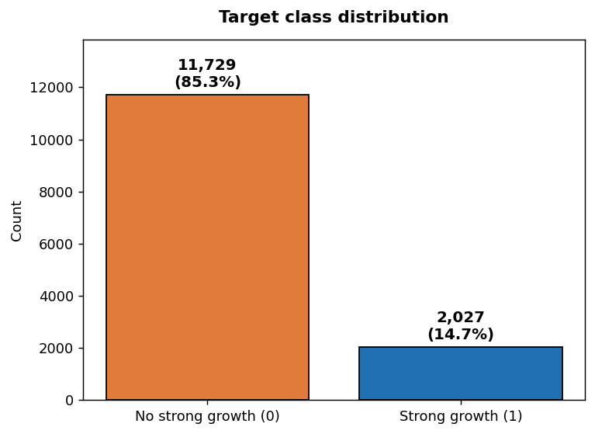
PROBLEM SET-UP
github.com/SunkeAnandasai3784
Model Inputs and Output (used consistently)
Inputs (X — 3 engineered features)
Class balance
QoQ_Growth_Rate — quarter-on-quarter (QoQ) change in registrations.
Volatility — rolling standard deviation of the last 4 quarters.
Market_Share — maker’s share of total quarterly registrations.
Features replaced earlier lag variables that were collinear (corr > 0.94).
Output (y — binary target)
Only ~15% of rows are strong-growth → imbalance ratio ≈ 5.8 : 1. This shapes both metric choice and the need for class-imbalance handling.
Target = 1 if YoY growth > 10% (strong growth), else 0.
YoY = year-on-year (vs the same quarter last year).
Anandasai Sunke · 24025759 · 7PAM2002 Data Science Project
4

Slide 5
METHODOLOGY
github.com/SunkeAnandasai3784
Pipeline & Why These Metrics
1
2
3
4
Build panel
Engineer features
Split
Model & tune
Filter to Cars, reshape to Make × quarter, add lags & rolling stats.
QoQ growth, volatility, market share (low collinearity).
Stratified train / validation / test = 7,737 / 2,580 / 3,439.
RF and XGBoost; GridSearchCV (5-fold) + learning curves.
Why accuracy alone is misleading here
With ~15% positives, a “predict all negative” model already scores 85% accuracy — so accuracy hides poor minority detection.
We therefore report ROC-AUC (ranking quality), precision & recall (minority class), F1 (their balance), and log loss — a proper scoring rule that penalises over-confident probabilities. Confusion matrices make the false-positive cost explicit.
Anandasai Sunke · 24025759 · 7PAM2002 Data Science Project
5

Slide 6
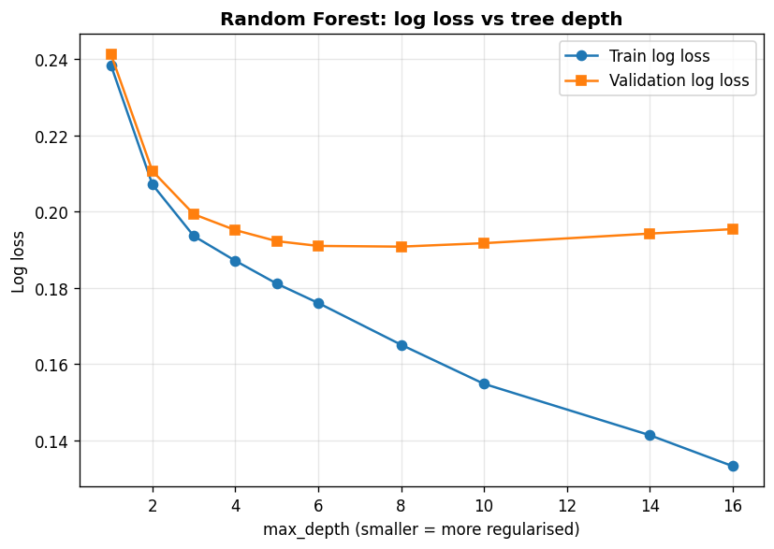
RANDOM FOREST — 1/2
github.com/SunkeAnandasai3784
Baseline & Overfitting Assessment
Reading the learning curve
RF log loss vs tree depth (train vs validation)
A deep, unconstrained forest memorises the training set: train log loss ≈ 0.06 but validation ≈ 0.27 — a large gap = overfitting.
Validation log loss is lowest around max_depth 6–8, then rises — deeper trees fit noise.
Fix: regularise via shallower depth and larger leaf size (applied in tuning).
Train 0.06 vs Validation 0.27 log loss → overfit
Anandasai Sunke · 24025759 · 7PAM2002 Data Science Project
6

Slide 7
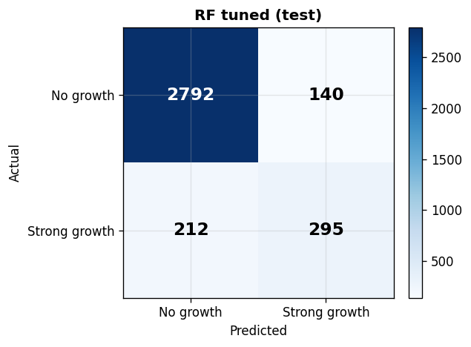
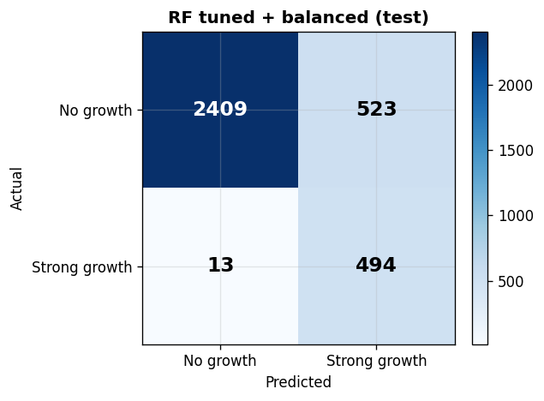
RANDOM FOREST — 2/2
github.com/SunkeAnandasai3784
Tuning & Class-Imbalance Trade-off
Before vs after (test set)
Tuned (FP = 140)
Balanced (FP = 523)
Stage | AUC | Recall | Prec. | FalsePos
Baseline | 0.939 | 0.546 | 0.620 | 170
Tuned | 0.949 | 0.582 | 0.678 | 140
Tuned + balanced | 0.948 | 0.974 | 0.486 | 523
Tuning roughly halves test log loss (0.27 → 0.19) and lifts AUC/F1 — it mainly controls overfitting.
Balancing: recall 0.58→0.97 BUT false pos 140→523
class_weight="balanced" catches almost every grower but floods false alarms — exactly the marker’s point. Choice depends on the cost of a missed grower vs a false alarm.
Anandasai Sunke · 24025759 · 7PAM2002 Data Science Project
7

Slide 8
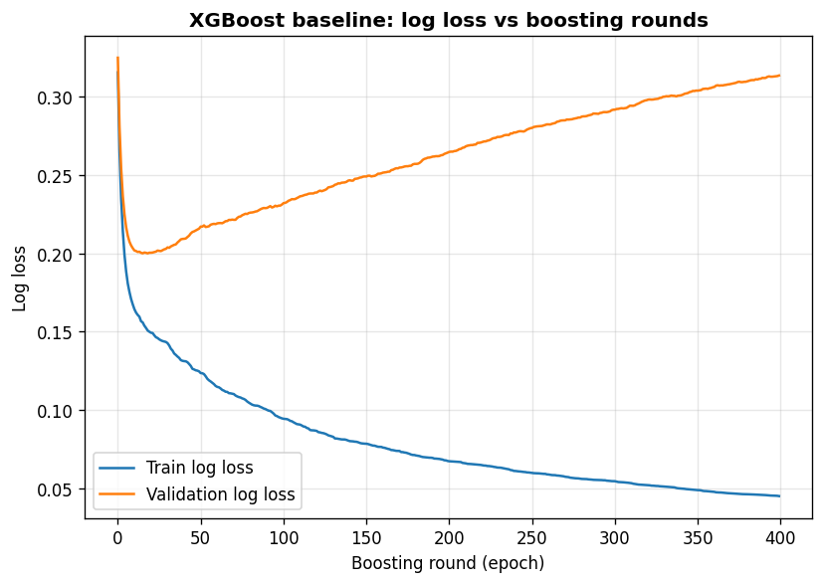
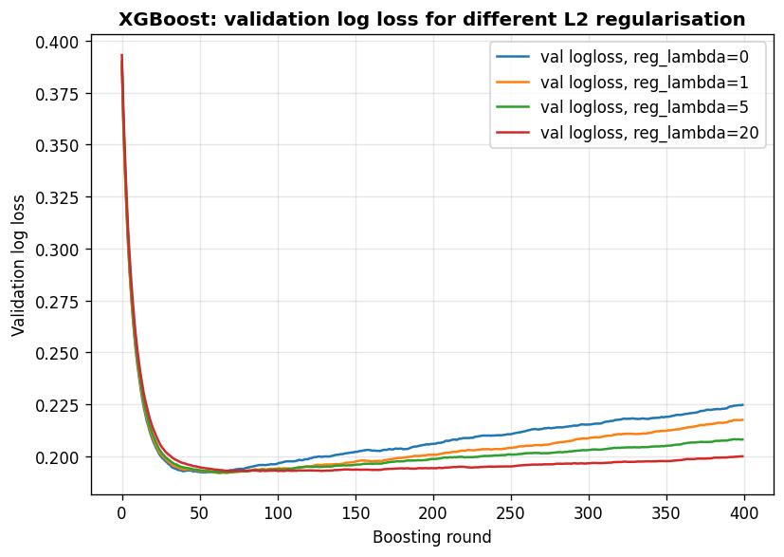
XGBOOST — 1/2
github.com/SunkeAnandasai3784
Overfitting per Epoch & Tuning
Boosting = a natural epoch curve
Baseline: log loss vs rounds
Validation vs L2 regularisation
XGBoost (eXtreme Gradient Boosting) adds trees one round at a time, so log loss can be tracked per boosting round.
Baseline (LR=0.3, no regularisation): validation bottoms at ~round 15 then climbs while train keeps falling — clear overfitting.
Lower learning rate + L2 regularisation flatten the validation curve; early stopping picks ~133 rounds.
Anandasai Sunke · 24025759 · 7PAM2002 Data Science Project
8

Slide 9
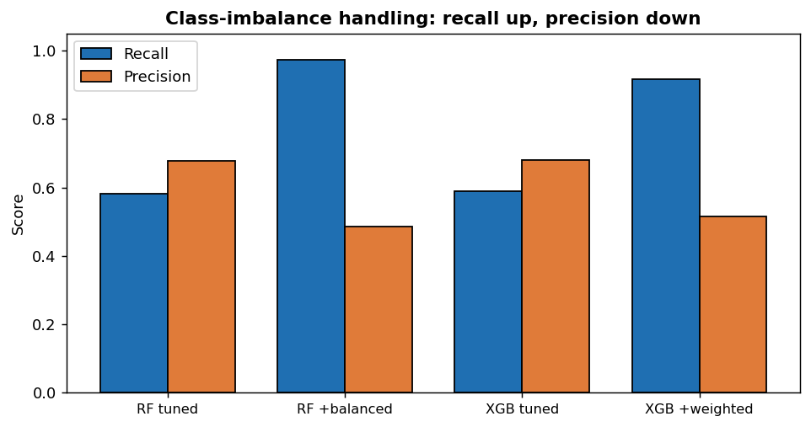
XGBOOST — 2/2
github.com/SunkeAnandasai3784
Tuned Model & Class-Imbalance Handling
scale_pos_weight = 5.79 (neg/pos)
Recall ↑ vs precision ↓ across both models
Stage | AUC | Recall | Prec. | F1 | LogLoss
Baseline (LR0.3) | 0.935 | 0.584 | 0.602 | 0.593 | 0.323
Tuned (LR0.05+reg) | 0.948 | 0.590 | 0.680 | 0.631 | 0.191
Tuned + weighted | 0.948 | 0.917 | 0.515 | 0.660 | 0.261
Same trade-off as RF: weighting lifts recall 0.59 → 0.92 but precision falls and false positives rise (141 → 438).
XGBoost handles the trade-off slightly better (higher F1)
Its regularisation limits how hard it chases the minority class, so it keeps more precision than the balanced RF at similar recall.
Anandasai Sunke · 24025759 · 7PAM2002 Data Science Project
9

Slide 10
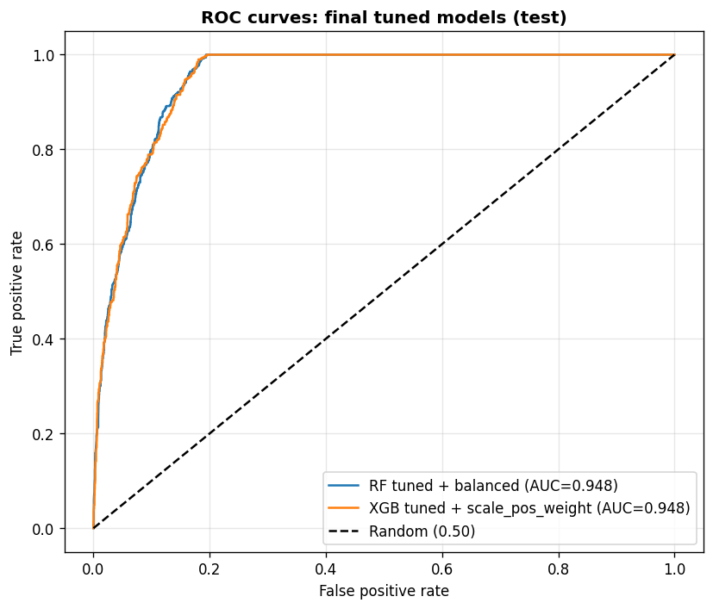
RESULTS
github.com/SunkeAnandasai3784
Model Comparison & ROC
Master comparison — test set
ROC — final tuned models
Model | Acc | Prec | Recall | F1 | AUC | LogLoss
RF baseline | 0.884 | 0.620 | 0.546 | 0.581 | 0.939 | 0.270
RF tuned | 0.898 | 0.678 | 0.582 | 0.626 | 0.949 | 0.190
RF tuned + balanced | 0.844 | 0.486 | 0.974 | 0.648 | 0.948 | 0.269
XGB baseline | 0.882 | 0.602 | 0.584 | 0.593 | 0.935 | 0.323
XGB tuned | 0.899 | 0.680 | 0.590 | 0.631 | 0.948 | 0.191
XGB tuned + weighted | 0.860 | 0.515 | 0.917 | 0.660 | 0.948 | 0.261
Both families reach AUC ≈ 0.95. Tuned (un-weighted) models hit ~90% accuracy (the project target). Weighting maximises recall/F1 at the cost of precision.
Anandasai Sunke · 24025759 · 7PAM2002 Data Science Project
10

Slide 11
DISCUSSION
github.com/SunkeAnandasai3784
Critical Analysis & Limitations
What works
Honest caveats
What I would improve
AUC ≈ 0.95 for both models — strong ranking of growers vs non-growers.
Tuning demonstrably controls overfitting (log loss roughly halved).
Market share and QoQ growth are the dominant predictors.
Contemporaneous design: features and target share the same quarter, so the model classifies a strong-growth quarter rather than strictly forecasting the next one — this inflates AUC.
Balanced models trade precision for recall: many false positives.
Only 3 features and 13,756 rows; no macro/EV-policy signals.
Lag features by one quarter for a true forecast and re-test.
Tune the decision threshold to the business cost of FP vs FN.
Add SHAP explanations and external economic features.
Anandasai Sunke · 24025759 · 7PAM2002 Data Science Project
11

Slide 12
CONCLUSION & NEXT STEPS
Machine learning can flag strong-growth UK car makers
Both Random Forest and XGBoost reach AUC ≈ 0.95; tuned models meet the ~90% accuracy target.
Class-imbalance handling is a deliberate recall-vs-precision choice, not a free win — quantified via false positives.
Next: convert to a true next-quarter forecast (lagged features), threshold tuning, SHAP explainability, and macro features.
Code & development history: https://github.com/SunkeAnandasai3784/SMMT-2025-UK-Car-Sales-Analysis
Anandasai Sunke · 24025759 · Supervisor: Vid Irsic · 7PAM2002 Data Science Project

Slide 13
REFERENCES
github.com/SunkeAnandasai3784
References
Methods & tools
Breiman, L. (2001) ‘Random forests’, Machine Learning, 45(1), pp. 5–32.
Chen, T. and Guestrin, C. (2016) ‘XGBoost: A scalable tree boosting system’, Proceedings of the 22nd ACM SIGKDD International Conference on Knowledge Discovery and Data Mining, pp. 785–794.
Pedregosa, F., Varoquaux, G., Gramfort, A. et al. (2011) ‘Scikit-learn: Machine learning in Python’, Journal of Machine Learning Research, 12, pp. 2825–2830.
Data & context
Department for Transport (2023) Vehicle licensing statistics: annual 2023 (VEH0160). London: DfT. Available at: https://www.gov.uk/government/statistics/vehicle-licensing-statistics-2023 (Accessed: 15 January 2025).
Society of Motor Manufacturers and Traders (2023) New car registrations by fuel type. London: SMMT. Available at: https://www.smmt.co.uk/vehicle-data/car-registrations/ (Accessed: 15 January 2025).
International Energy Agency (2023) Global EV outlook 2023: catching up with climate ambitions. Paris: IEA. Available at: https://www.iea.org/reports/global-ev-outlook-2023 (Accessed: 15 January 2025).
Anandasai Sunke · 24025759 · 7PAM2002 Data Science Project
13

